Slide 1


Introduction to Data Engineering
Kampus Merdeka, Day 1

Slide 2

Hello!
I am Thosan G. S.
You can call me Seceng.
You can find me at
linkedin.com/in/thosan or
You can contact me on
thosan.girisona@gmail.com

Slide 3

Sharing Outline
History of Data Engineering
Ingestion & Integration Stage
Data Processing
1
3
5
Intro Quiz
7
0
Open Discussion
2
4
6
Data Engineer & Data Scientist
Data Storage
Other Fundamentals…

Slide 4
1
History of Data Engineering
Kenapa profesi ini dibutuhkan pada mulanya

Slide 5
Cerita lama tentang dia data
1980-2000
2000-2010
2010-2020
2010-2020
Notes:
Lah kok dari 1980?, yep, gw juga kaget kok. Tapi mari kita bahas aja

Slide 6

90s.
Awalnya dari Data Warehouse
Bill Inmon & Ralph Kimball
Muncul BI Eng, DW Eng, ETL Dev, mainly to tackle a data ‘movement’ using SQL
90s is the year Internet became mainstream
Mostly monolith & heavily licensed
Dotcom bubble (1998ish)
1
Notes:
Ralph Kimball, The Godfather of Data Warehouse. Karena teknologi belum terlalu ‘maju’, mostly yang mengelola platform data itu cuma ada di perusahaan besar. Well, karena SQL juga baru tenar sekitar tahun 80an dari IBM. Dulu MPP tu refer ke multi-processor, bukan distributed computing. Yang tajir dari SQL in its early phase tu oracle

Slide 7
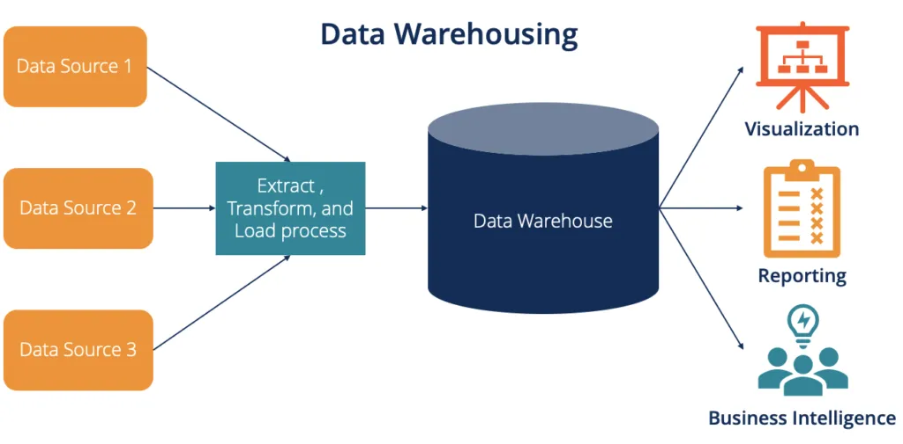
Notes:
This is it, dari database sumber, biasanya dari database anak usaha, di join jadi 1 data warehouse

Slide 8

Early 2000
Booming istilah Big Data
Google File System & MapReduce paper (2004)
Hadoop by Yahoo (2006)
AWS started to grow. GCP and Azure followed the footsteps
Notes:
Jeff Dean, co-inventor of mapreduce. Winter berakhir, terlahirlah survivor. Karena hardware semakin murah, dibutuhkan alat untuk combine multiple computer. Karena nambah komputer itu lebih murah ketimbang menambah core di CPU. Beda di profesinya apa?, dulu cuma pake SQL, sekarang lebih wide lagi istilah ETL dan MPP nya, karena bisa pake MapReduce untuk mengolah data, dan data nya ga harus ‘structured’ per say, bisa apapun. Dan lagi MPP nya ga cuma multi-processor, tapi multi-node. This is where DE started to meet with soft-eng. Bahas lebih jauh terkait hadoop

Slide 9
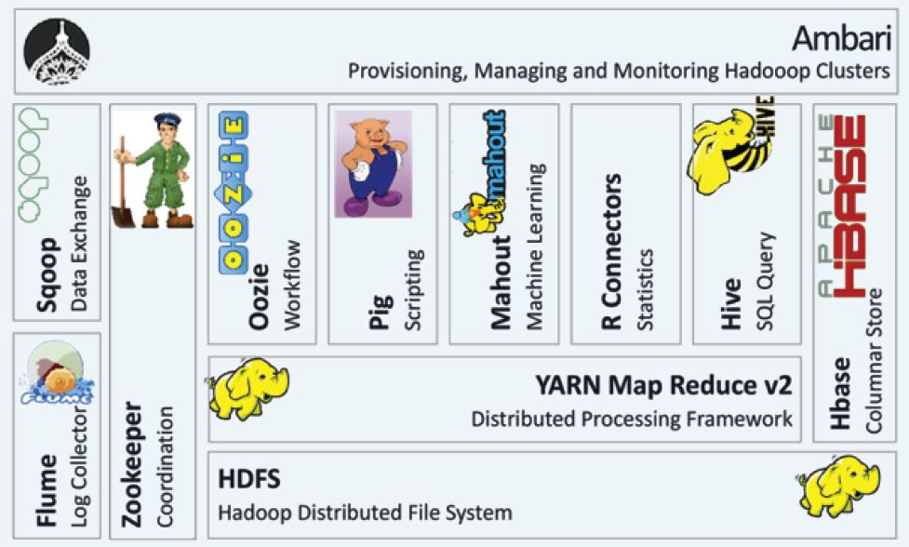

Slide 10

~2014
Makna sebenarnya “Unified”
MapReduce takes a quite complex engineering challenge
So many ‘specialized’ skills needed
Integration between those open-sources is ‘hard’
Slow, because hadoop is based on HDD, not memory.
1
Notes:
Matei Zaharia, Inventor of Spark. Awalnya itu dipake untuk testing mesos, tapi kok kenceng, dan semakin kesini harga memory makin murah. Ya make sense aja orang pindah dari HDFS ke in-memory processing, dan spark is their only choice. Presto by facebook juga salah satu game-changer, karena dia bisa gantiin Hive sebagai query engine, dan dia juga in-memory. Faktor lain migrasinya developer yaitu low-cpu utilization, karena node Hadoop biasanya storage nya kepake banget, tapi CPU nya kecil banget utilisasinya. Karena node addition itu perlu add CPU juga, jadinya under-utilized

Slide 11
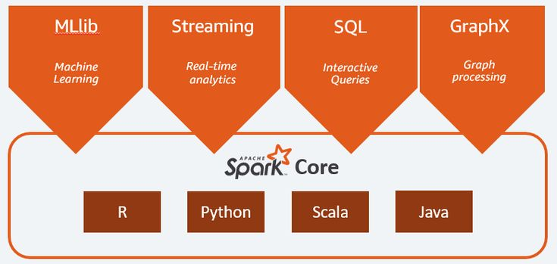

Slide 12
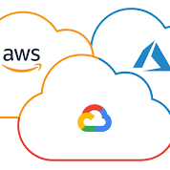
2020 Later
Job Shifting
Elastic workload and pricing
More old “enterprisey” job for DE again
Less Monolith, More Decoupled
Booming new tools, the golden age for DE
Notes:
Makin banyak yang kontribusi ke data quality, data security, dan data governance. Well, ya karena ‘undifferentiated heavy lifting’ nya udah ga di engineers lagi.

Slide 13
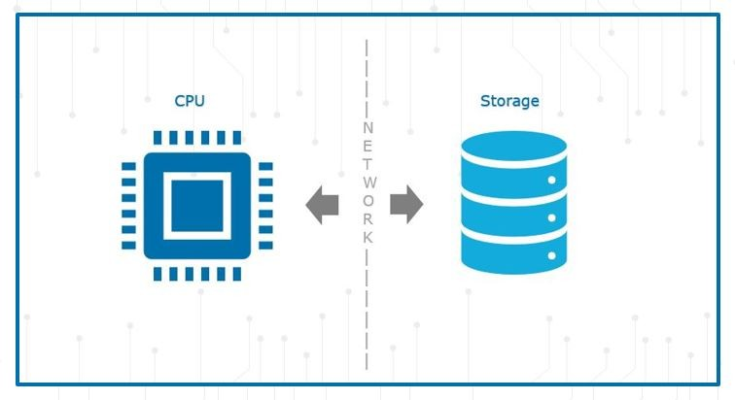
Notes:
Apakah hari minggu kita masih butuh server?, storage nya iya, tapi compute nya engga. Ini yang bikin cloud jadi menggoda. Simply karena early investment nya kecil

Slide 14
2
Data Engineer & Data Scientist
Mirip ga si, mirip kan ya?, ya ga ya ?

Slide 15
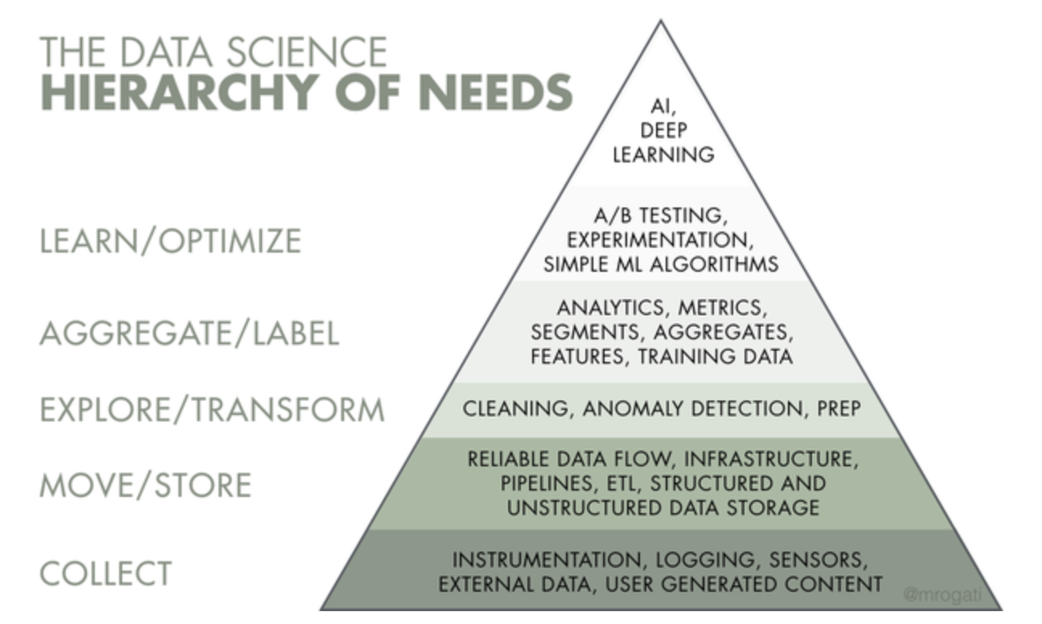
The ‘Hierarchy’
Notes:
Data engineers itu biasanya kerja sebagai ‘penyupply’ data. Karena sumber data nya banyak, butuh orang yang maintain integrasi-integrasi tsb. Tapi seiring waktu, DE juga banyak yang kontribusi ke data as product. And as you might know, your normal data might be other’s valuable data, misalnya CDP. Topik lain yang asik dibahas disini tu ML engineers, karena mananya ML, tapi engineers juga. Dan di banyak perusahaan IT, utamanya startup, ML & AI itu terakhir banget, yang pertama itu make sure datanya bisa dipake, datanya ‘aman’, dan bisnis insight nya muncul. So lebih penting churn + retention ketimbang ML modelling IMO. Sehingga jargon AI itu beneran mahal dari sisi investment, tapi emang banyak research yang bilang kalo dengan AI itu company bisa grow ~30%. That is very very big.

Slide 16
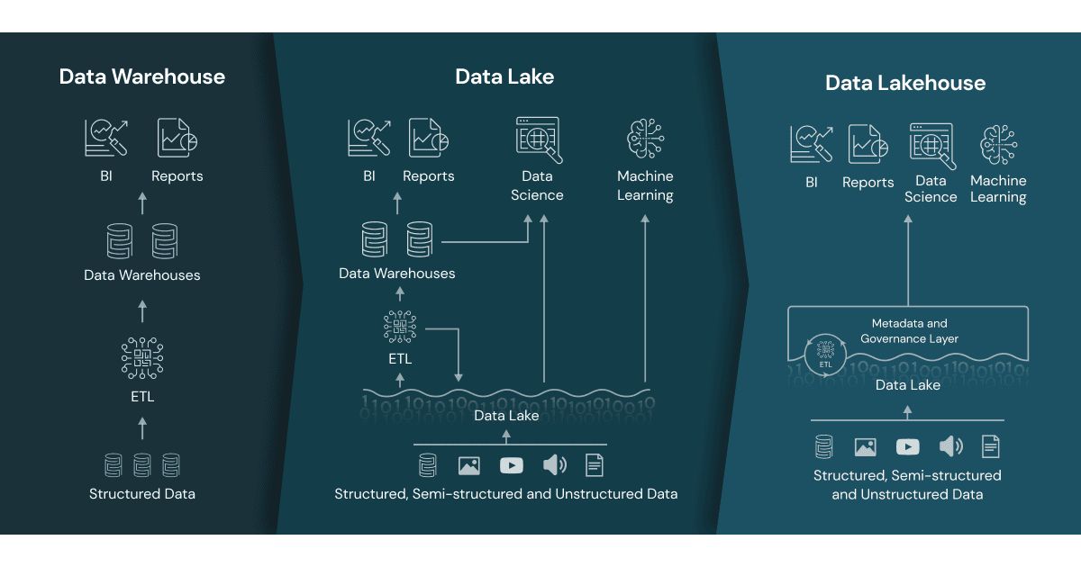
The ‘Lifecycle’

Slide 17
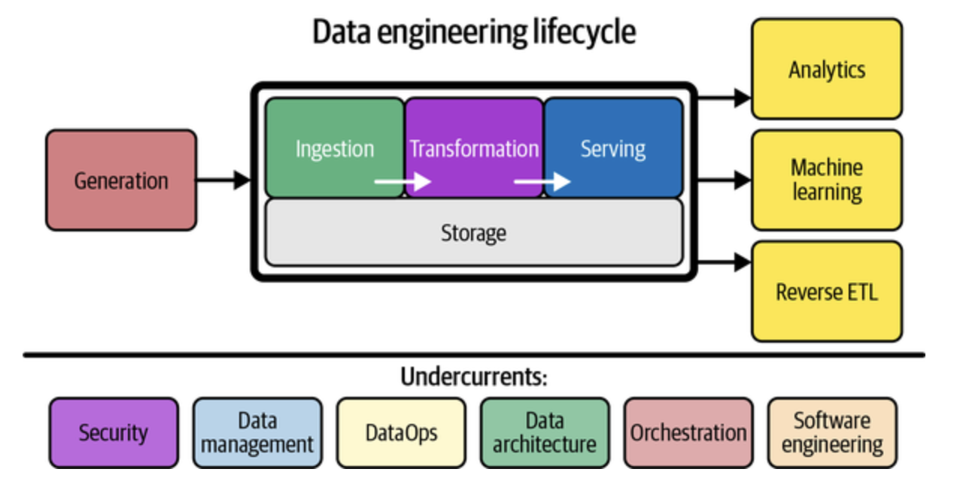
The ‘Lifecycle’ (cont)
Notes:
Nah ini garis beasrnya. Beneran besar-nya.
Data dihasilkan di suatu tempat (Generation)
Data masuk ke sistem (Ingestion)
Data combining & cleaning (Transformation)
Data modelling & serving in multi-platform (Serving)
Consumed by analytics, ML, and reverse ETL to used in other products.
The interesting part is the reverse ETL, because most of the time your data is produced by product, but in the end, in is being used again for the product development. So we only serve as the middle man, kind of
The undercurrents (arus bawah) juga ga kalah penting, platform yang kita bangun bakal sulit banget dipake kalo ga ada tools penunjang.
Security, misalnya data PII terkait GDPR dan PDPA. Juga UU ITE
Data management, make sure the correct role get the correct data in the correct manner
DataOps, make sure your deployment is not taking up your time (CI/CD)
Data architecture, ini kaya monolith vs distributed. Bahasa data nya tu centralized dan data-mesh
Orchestration, airflow, enough said
Soft-Eng, make sure your app is tested, readable, and developable.

Slide 18
3
Ingestion & Integration Stage
Sumber air su-dekat. Sumber data su-banyak

Slide 19
SQL RDBMS Databases
Postgres, MySQL, SQLServer
NoSQL Databases (OLTP)
MongoDB, CouchDB
Files
CSV, XLSX, JSON, Parquet
APIs
Public API, 3rd Party API
Message Broker
Kafka, RabbitMQ
Type Of
Sources
Notes:
Q : Kalian pernahnya ngolah data yang bersumber dari yang mana ?
Intro and go a bit deeper to Message Broker

Slide 20
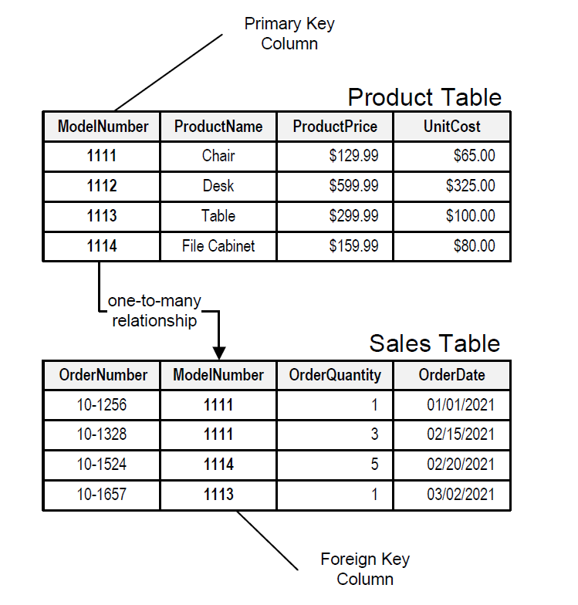
RDBMS
Notes:
Transaction purposes, intro to kafka

Slide 21
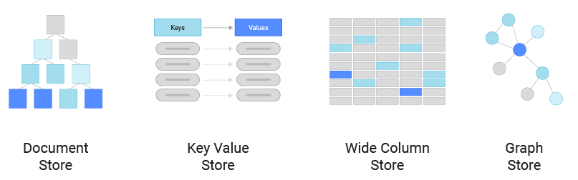
Notes:
Document Store = MongoDB, CouchDB
Key value Store = redis
Wide Column = HBase, Cassandra
Graph = Neo4J

Slide 22
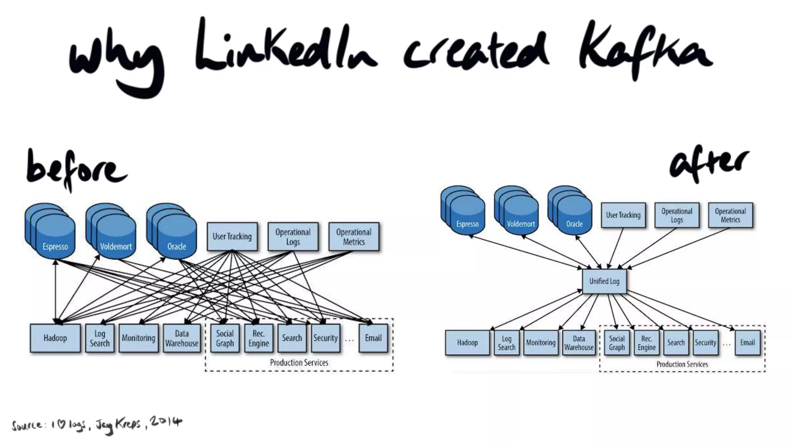
Type of Source (cont)
Notes:
Inilah alasan kenapa kafka/message broker itu dibutuhkan. Intinya adalah untuk decoupling system yang tadinya tightly coupled one another. Bayangin kita udah ada 100 sistem lama, lalu mau add 1 sistem baru yang butuh service dari 100 system tadi, lumayan time consuming kan bikin 100 koneksi. Daripada gitu, mending bikin 1 intermediary (broker) untuk jadi bridging. Data di kafka topic itu immutable

Slide 23
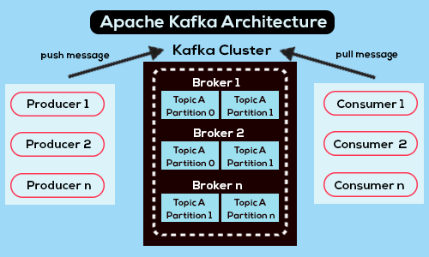
Kafka Architecture
Notes:
Broker itu semacam database engine nya
Topik itu kaya table
Partition itu multiplicationnya, supaya bisa handle multi-read dengan low latency
1 key is guaranteed to land on an exactly one partition consistently
Since the partition itself is now the fault point, we need to duplicate the partition, that is a replication

Slide 24
Batch load
Daily batch load (Airflow + Python/Spark/SQL)
Stream processing
Event based, mostly kafka consumer (Spark Streaming/ Beam/ Storm)
Change Data Captures
Listen and recreate a database event (Debezium)
Type Of
Ingestions
Notes:
Q : Kalian pernahnya ngolah data yang bersumber dari yang mana ?

Slide 25
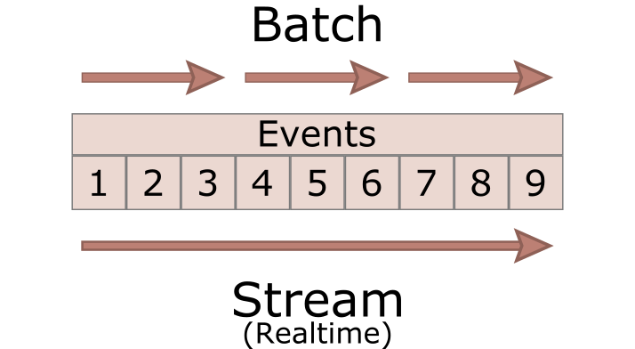
Batch & Stream

Slide 26
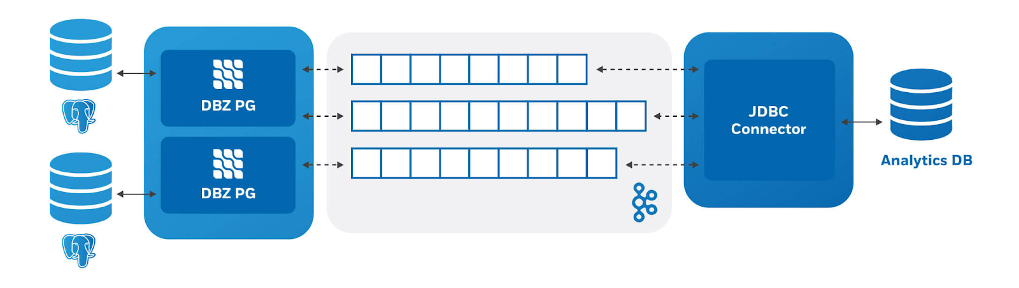
Change Data Capture

Slide 27
4
Data
Storage
Tempat bersandarnya data

Slide 28
File
Normal
CSV, JSON, Pickle, Parquet
Columnar (Open table Format)
Parquet, Hudi, Iceberg, Delta
SQL Database
Postgres, MySQL, SQLServer, Oracle
NoSQL Database (OLAP)
Document Based
MongoDB
Columnar
HBase, Cassandra (Wide-Column)
High Level
Storage
Notes:
Q : Seberapa besar size data yang pernah kalian pegang/olah/lihat ?

Slide 29
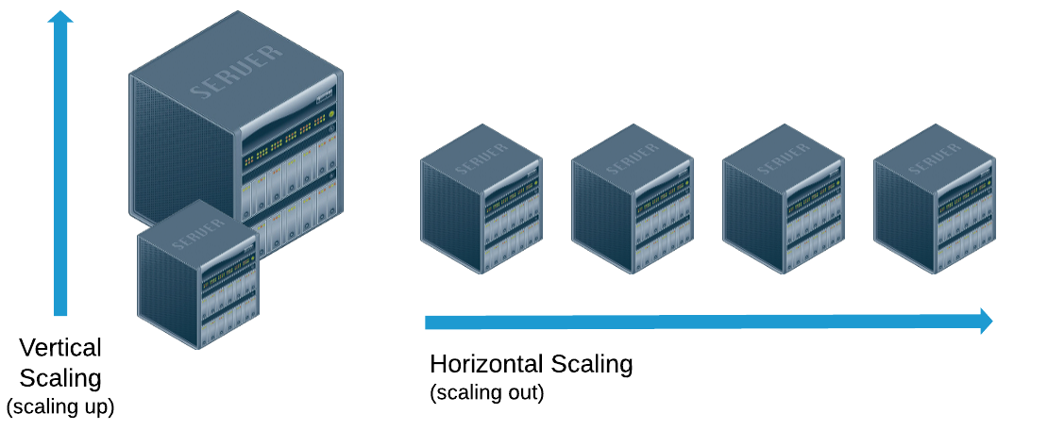

Slide 30
‘Normal’ Storage
HDD, biggest currently ~22TB
SSD, biggest currently ~100TB
Low Level
Storage
Notes:
Q : Seberapa besar size data yang pernah kalian pegang/olah/lihat ?
Normal storage means, itu konslet, datanya ilang. Done. Dari pengalaman, do not push company to go to distributed computing/storage if it still can handle the load well.You should distribute and replicate your data in multiple data storage, just for safety reason.

Slide 31
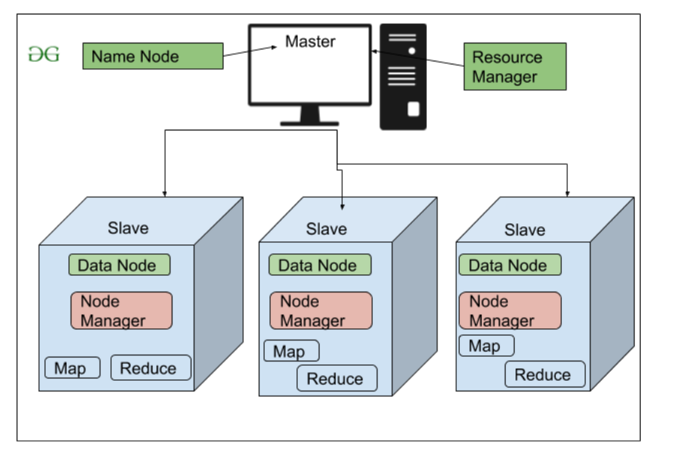
Distributed Storage
Notes:
Hadoop architecture.
But in each data node, kita juga butuh CPU, tapi underutilized sayangnya.
Hari sabtu/minggu, bisa ga si matiin server ?, nope

Slide 32
AWS S3, GCP GCS, Azure Blob Storage, Azure ADLS
Cloud Data Warehouse
BigQuery
Snowflake
Open Table Format
Delta Lake
Apache Iceberg
Apache Hudi
Cloud
Storage
Notes:
OTF lagi naik daun karena beberapa company lagi shifting ke Lakehouse

Slide 33
Data Lakehouse

Slide 34
5
Data
Processing
Bagaimana data diambil, diolah, dan disajikan. kaya dessert

Slide 35
Database Engine
Postgres, MySQL, SQL Server, Oracle
Hadoop MapReduce
Java Only
Spark
Scala, Java, Python, and R
Query Engine
HIVE, Presto, Trino, AWS Athena
DW-Grade Engine
Snowflake, BigQuery
Processing
Engine
Notes:
OTF lagi naik daun karena beberapa company lagi shifting ke Lakehouse

Slide 36
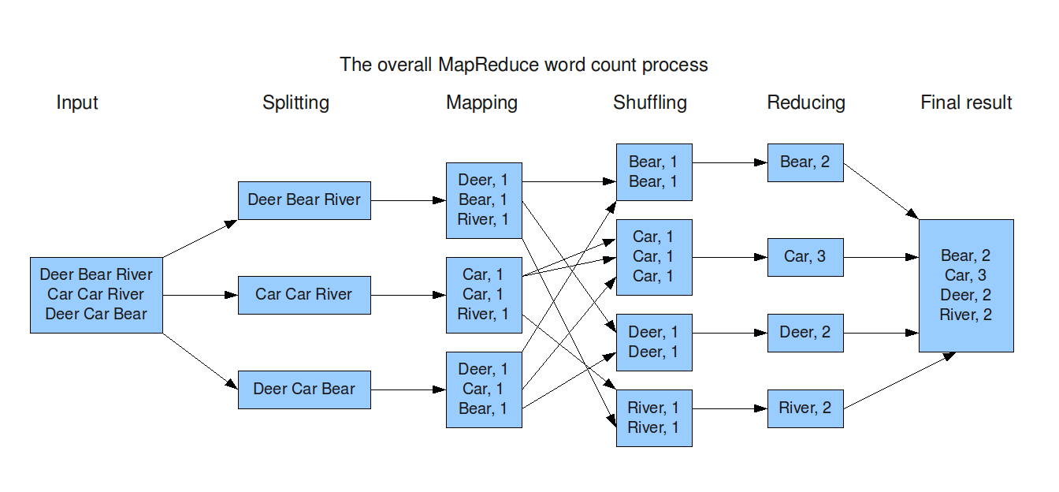
Hadoop MapReduce

Slide 37
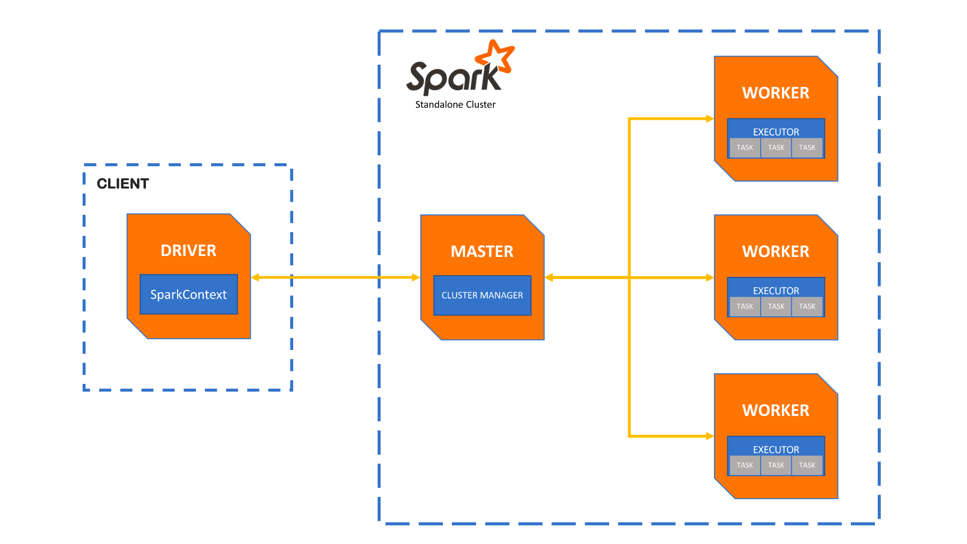
Spark

Slide 38
6
Other Fundamentals
Penyokong data platform in general

Slide 39
Security
IAM, least-privilege policy, Ethics
Data Governance
Discoverability, Observability, Lineage
DataOps
Data Architecture
Orchestration
Airflow, Luigi
Software Engineering
Git, CI/CD, Unit-Test
Under
Currents
Notes:
OTF lagi naik daun karena beberapa company lagi shifting ke Lakehouse

Slide 40
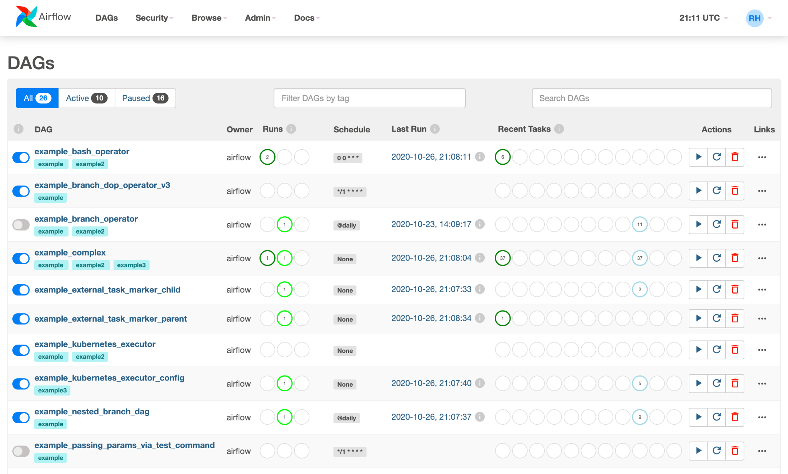
Airflow
Notes:
Ada yang sudah pernah make atau install sebelumnya ?

Slide 41
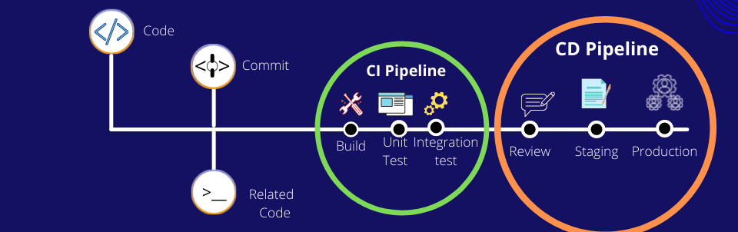
Git & CI/CD

Slide 42
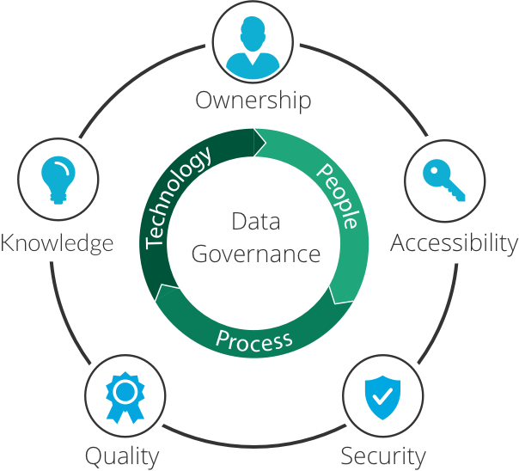
Data Governance

Slide 43
7
Data Engineering Journey & Roadmap
Mulai aja dulu, kayak slogan ecommerce ijo

Slide 44
The Journey
Advanced Python scripting
Basic usage of SQL & NoSQL + Analytical function
Data wrangling and good data pipeline engineering practices
Understanding the concept of data orchestration and its usage using airflow
Get a deep understanding of how API works and its implementation
A wider overview of how to solve Data governance problem.
Python
GIT
SQL
DWH
ETL
DOCKER
AIRFLOW
Cloud
API
Web Scraping
Data Governance
Understanding of basic GIT
Data Warehouse architecture
The concept of docker and virtualization
Understand multiple services and its equivalent in cloud
Know how to extract information on API-based data source

Slide 45

When you jump into the unknown, you will find a net usually appears to catch you
Notes:
Steven Aitchison, Writer

Slide 46
Personal Opinions
BIGGEST BARRIER
Too many tools, enough said.
mattruck.
BIGGEST CHALLENGE
Keeping up with the grow of the data tools space.
EARLY MOTIVATION
Gemastik 2015 at UGM, we can not even wrangler the data.
Notes:
Biggest barrier:
Karena toolsnya banyak, calon company kalian nanti juga kemungkinan besar akan pake stack data berbeda dari yang udah di sharing disini
Never stop learning, make your fundamentals stronger and keep reading the news. Yes, the news

Slide 47
We are surrounded by data, but starved for insight
Notes:
Jay Baer, Marketer

Slide 48
References
Fundamentals of Data Engineering - O’reilly
Learning Spark - O’reilly
Data Engineers Influencer
Benjamin Rogojan (SeattleDataGuy)
Daniel Beach (Data Engineering Central)
Bill Inmon (you remember him, right?)

Slide 49
Thank you
Mulai diskusi ?
Let’s go back to sli.do. Btw you still can find me at
linkedin.com/in/thosan
thosan.girisona@gmail.com

Slide 50


Audience Q&A Session
ⓘ
Click Present with Slido or install our Chrome extension to show live Q&A while presenting.
Notes:
📣 This is Slido interaction slide, please don't delete it. ✅ Click on 'Present with Slido' and the questions from your audience will appear when you get to this slide.

